Slide 1
Being Staff Plus
The Individual Contributor Track
@ICooper
@ICooper@hachyderm.io
@icooper.bsky.social

Slide 2
Who are you?
Software Developer for more than 25 years
Stuff I care about: Messaging, EDA, Microservices, TDD, XP, OO, RDD & DDD, Code that Fits in My Head, C#
Places I have worked: DTI, Reuters, Sungard, Beazley, Huddle, Just Eat Takeaway
No smart folks
Just the folks in this room

Slide 3
My Staff Plus History
Been doing Staff Plus roles since 2004
We has different names
Lead, Architect…
But the roles were the same as those we now cluster under Staff Plus
(Old roles such as Technical Authority (TA) are also Staff Plus)
Principal (Senior) since 2019
Been various archetypes (see later)
Sometimes had line management responsibilities

Slide 4
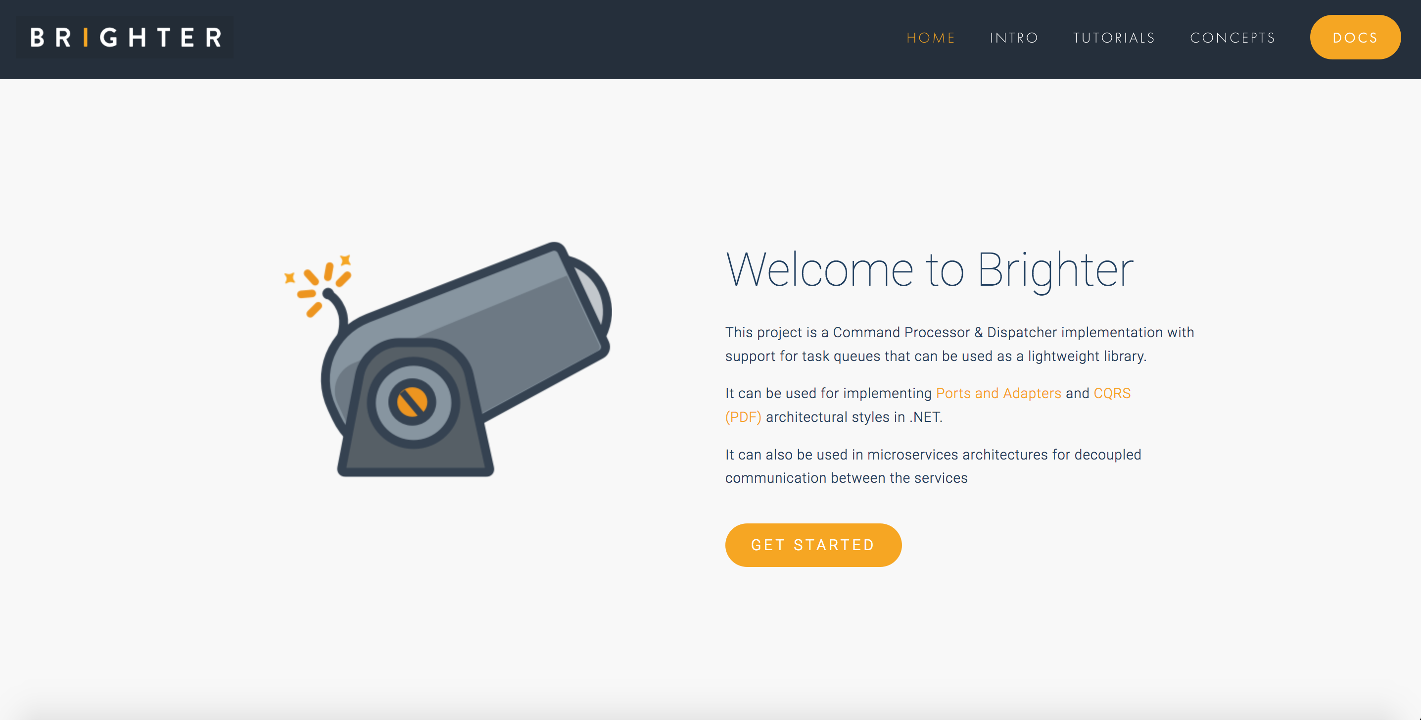

Slide 5
Agenda
T:3
Staff Plus Roles and Archetypes
Moving Beyond Code
Technical Leadership
Work on What Matters

Slide 6
The Engineer’s Path
Staff Plus Roles and Archetypes
Moving Beyond Code
Technical Leadership
Work on What Matters
Jr. Eng
Mid Eng
Snr Eng
Staff Eng
Snr Staff Eng
Principal Eng.
Snr Principal
Distinguished
Notes:
Jr. Eng => [Mid.Eng] => Snr. Eng => Staff Eng => Snr Staff Eng => Principal Eng => [Snr Principal] => Distinguished
[Larger Org needing more heirachy]

Slide 7
Senior or Staff Plus?
Staff Plus Roles and Archetypes
Moving Beyond Code
Technical Leadership
Work on What Matters
Senior is the highest individual contributor role inside a team
- Lowest role where you can opt to remain at that level.
Staff is the lowest individual contributor across teams
- Broader technical perspective than within team (local optima)
- Cross-Team Fertilization
- Mentoring
- Design here is architecture: significant change by cost or reasoning
Notes:
Senior inside a team, staff plus across teams
broader perspective avoid local optima
cross team fertilisation
mentoring
architecture where significant by cost of change or reason about

Slide 8
Staff Plus Archetypes
Staff Plus Roles and Archetypes
Moving Beyond Code
Technical Leadership
Work on What Matters
Leader: Guides approach and execution of a particular team
Designer: Ensures sustainable architecture via quality attributes
Solver: Digs deep into complex problems and finds the path forward
Messenger: Rides the “architecture elevator” [Hohpe]
You may switch between archetypes as ”work on what matters” changes.
After Will Larson, Staff Engineer, Leadership Beyond the Management Track
Notes:
Will Larson is actually:
The Tech Lead guides the approach and execution of a particular team. They partner closely with a single manager, but sometimes they partner with two or three managers within a focused area. Some companies also have a Tech Lead Manager role, which is similar to the Tech Lead archetype but exists on the engineering manager ladder and includes people management responsibilities.
The Architect is responsible for the direction, quality, and approach within a critical area. They combine in-depth knowledge of technical constraints, user needs, and organization level leadership. The Solver digs deep into arbitrarily complex problems and finds an appropriate path forward. Some focus on a given area for long periods. Others bounce from hotspot to hotspot as guided by organizational leadership.
The Right Hand extends an executive’s attention, borrowing their scope and authority to operate particularly complex organizations. They provide additional leadership bandwidth to leaders of large-scale organizations.
Larson, Will. Staff Engineer: Leadership beyond the management track (pp. 16-17). Will Larson. Kindle Edition.

Slide 9
Manager’s Track
Staff Plus Roles and Archetypes
Moving Beyond Code
Technical Leadership
Work on What Matters
Jr. Eng
Mid Eng
Snr Eng
Staff Eng
Snr Staff Eng
Principal Eng.
Snr Principal
Distinguished
Jr. Eng
Mid Eng
Snr Eng
Tech Mgr
Snr Tech Mgr
Head Of
VP
Director
You can switch paths – and move back and forth – though not always at the same level
Notes:
parallels manager track
Jr. Eng => [Mid.Eng] => Snr. Eng => Technical Manager => [Snr Technical Manager Eng] => Head Of => [VP] => [Director]
Delivery track
Product Track

Slide 10
The Iron Triangle
Staff Plus Roles and Archetypes
Moving Beyond Code
Technical Leadership
Work on What Matters
Staff
Manager
Product
Advocates for Quality
Advocates for
Cost/Time
Advocates for
Scope
The three roles advocate for different aspects of the Iron Triangle – Scope, Quality, Cost/Time
Notes:
quality, scope, people
staff advocate for quality, manager for people, product for scope;
provides balance; holds long term view
senior might do in smaller org, but it’s all time not coding

Slide 11
Scope of the Role
Staff Plus Roles and Archetypes
Moving Beyond Code
Technical Leadership
Work on What Matters
How
What
Junior Engineer
Execute with Supervision
Staff Engineer
Requirements to Tasks
Principal Engineer
Own Problems, Generate Requirements
Senior Engineer
Execute Task with Supervision
Senior Staff Engineer
Requirements to Design
Distinguished Engineer
Find Problems
Nothing “Out of Scope”
Yonatan Zunger, https://leaddev.com/leaddev-live/role-and-influence-ic-trajectory-beyond-staff
Notes:
Jr Eng - Execute with Supervision => Junior Grade => About the How
Sr Eng - Execute Task with Supervision => Junior Grade => About the How
Staff - Requirements to Tasks => Mid Grade => About the What
Sr Staff - Requirements to Design => Mid Grade => About the What
Principal Eng - Own Problems, Generate Requirements => Snr Grade => About the What
Distinguished - Find Problems => Snr Grade => About the What

Slide 12
Bad Ideas
Staff Plus Roles and Archetypes
Moving Beyond Code
Technical Leadership
Work on What Matters
Assuming IC and Management Tracks are mutually exclusive
- You can swap between the two tracks.
- You may not be able to swap at the same level without experience.
- You can swap back and forth, often to regularly refresh tech skills.
Not having both IC and Management Tracks
- People management should not be the only route beyond senior.

Slide 13
Agenda
T:3
Staff Plus Roles and Archetypes
Moving Beyond Code
Technical Leadership
Work on What Matters

Slide 14
The Four Skill Sets
Staff Plus Roles and Archetypes
Moving Beyond Code
Technical Leadership
Work on What Matters
Core Technical Skills: Software Engineering
Product Management: Narrative and Strategic Vision
Project Management: Making Sure It Happens
People Management: Find People and Motivate Them
- The more senior you are, regardless of title, the more the expectation you can pivot to any of these roles.
- You can be hyper-specialist, but you won't grow influence across the org which limits how senior you will rise.
Yonatan Zunger, https://leaddev.com/leaddev-live/role-and-influence-ic-trajectory-beyond-staff
Notes:
Core Technical Skills - Software Engineering
Product Management - Narrative and Strategic Vision
Project Management - Making Sure it Happens
People Management - Find People and Motivate Them
The more senior you are, regardless of title, the more the expectation you can pivot to any of these roles.
You can be hyper-specialist, but you won't grow influence across the org which limits how senior you will rise

Slide 15
People, Process and Technology
Staff Plus Roles and Archetypes
Moving Beyond Code
Technical Leadership
Work on What Matters
Team
Teams
Engineering
Organization
Staff Engineer
Technical Leadership for a Team
Senior Staff Engineer
Technical Leadership for a Project
Principal Engineer
Technical Leadership for a System
Work Alongside Product
Distinguished Engineer
Lead on Strategy
Nothing “out of scope”
Yonatan Zunger, https://leaddev.com/leaddev-live/role-and-influence-ic-trajectory-beyond-staff
Notes:
It's also about people and process competence - all engineering skills
Staff => Work with Team, Technical Leadership for a Team
Staff Plus => Work with Teams, Technical Leadership for a Project
Principal => Work with Engineering, Technical Leadership for Engineering, Work Alongside Product
Distinguished => Work with Org, Lead on Strategy, Nothing "out of scope"

Slide 16
Choose Your Shape
Staff Plus Roles and Archetypes
Moving Beyond Code
Technical Leadership
Work on What Matters
Broad Technical Knowledge
Deep Technical Knowledge
Leadership and Executive Skills
Deep Technical Knowledge
Deep Technical Knowledge
Notes:
What is your scope
T-Shaped
you identify with a specialism
but you are general enough to solve non-specialism problems
beware being dragged away from specialism into broad
X-Shaped
You solve problems that require a wider viewpoint
A little bit of everything, breadth of understanding over depth
Beware loss of core skills
I-Shaped
a hyper-specialist
beware loss of organisational influence, senior roles are rarely 'core technical skills only'
org must be large enough
Give examples of tasks (from experience)

Slide 17
It Remains A Technical Role
Staff Plus Roles and Archetypes
Moving Beyond Code
Technical Leadership
Work on What Matters
May not make sense to be a “code monkey”
- You will write less code
- If some one else could write the code should you?
How much code?
- Staff Plus Roles might be no more than 20% "working with code"
- Goal is to keep technical skills "fresh"
- Risk of becoming a blocker if you own coding tasks.
- Pair or Mob instead
Notes:
May not make sense to be a “code monkey”
You will write less code
If some one else could write the code it may not be best use of your time.
How much code?
Staff Plus Roles need about 20% "working with code"
Your goal is to keep technical skills "fresh" so that you understand what teams have to do
Your goal is not to be the "hero" contributor
Could someone else write the code?
No, Pair or Mob
Yes, let them do it, possibly review
Risk of becoming a blocker if you "own" stories
Pair or Mob instead

Slide 18
How To Keep Coding
Staff Plus Roles and Archetypes
Moving Beyond Code
Technical Leadership
Work on What Matters
Ride Along
Pair Programming
- Avoids Blocking a Team
- Understand team’s experience
- You share design skills/experience
- Goal is to look for friction
- You gain insight
- Goal is to use new understanding to fix friction
Notes:
POC
Write a scratch version to learn
mob/pair to transfer knowledge
Hand-over but check in
OSS (Internal or External)
OSS means you share ownership
Solve "repeated" problems
You will read code
Code reviews, pairing
architecture/design
trade-offs
Ride Along
Being a developer to “feel” how it is working now
Goal is to understand results of initiative
Move back up to use level to make change based on what you know

Slide 19
How To Keep Coding
Staff Plus Roles and Archetypes
Moving Beyond Code
Technical Leadership
Work on What Matters
POC
OSS
- Write an example or template
- Hand Over But Check Back In
- Solve a common requirement
- Look for contributors
Notes:
POC
Write a scratch version to learn
mob/pair to transfer knowledge
Hand-over but check in
OSS (Internal or External)
OSS means you share ownership
Solve "repeated" problems
You will read code
Code reviews, pairing
architecture/design
trade-offs
Ride Along
Being a developer to “feel” how it is working now
Goal is to understand results of initiative
Move back up to use level to make change based on what you know

Slide 20
Bad Ideas
Staff Plus Roles and Archetypes
Moving Beyond Code
Technical Leadership
Work on What Matters
Assuming you have to be the best coder in the room
Privilege core skills only
Becoming post-technical
Notes:
Teaching others to privilege core skills only
Becoming post-technical

Slide 21
Agenda
Staff Plus Roles and Archetypes
Moving Beyond Code
Technical Leadership
Work on What Matters

Slide 22
Leadership not Management
Staff Plus Roles and Archetypes
Moving Beyond Code
Technical Leadership
Work on What Matters
Leadership not Management
- If you are not a manager, you will not have authority
- No authority over resources: people and money
- No authority over road maps
- So you will need to work via influence
- You share a vision by talking about it.
Notes:
Leadership not Management
If you are not a manager, you will not have authority
No authority over resources: people and money
No authority over road maps
So you will need to work via influence

Slide 23
You Need A Map
Staff Plus Roles and Archetypes
Moving Beyond Code
Technical Leadership
Work on What Matters
Who are your key stakeholders?
How does something get done: soup to nuts?
How do ideas get shared? Slides, narratives, miro boards?
Engineering Culture: guilds, AAF, principles, practices, tenets
Org Priorities: Tolerance for Risk, Technical Debt, Rework, Availability, etc.
The Org Chart
The Shadow Org Chart
Notes:
Who are your key stakeholders?
How does something get done: soup to nuts
How do ideas get shared? Slides, narratives, miro boards?
Engineering Culture: guilds, advice forums, principles, practices, team independence
Org Priorities: Attitude to technical risk. A startup trying to get market share is different to a risk-averse incumbent
The org chart is often a lie
People have influence and that is not shown in the org chart

Slide 24
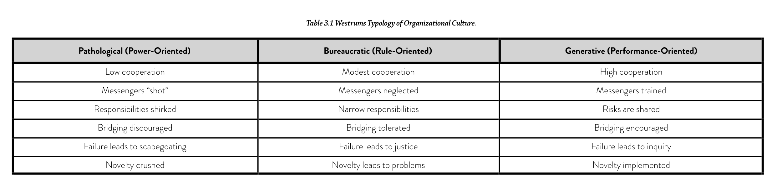
Organizational Culture
Staff Plus Roles and Archetypes
Moving Beyond Code
Technical Leadership
Work on What Matters
Forsgren, Humble, Kim – Accelerate
Notes:
Westrum - Information Flow Good information flow in an organization
It provides answers to the questions that the receiver needs answered.
It is timely.
It is presented in such a way that it can be effectively used by the receiver.

Slide 25
Yes, Politics
Staff Plus Roles and Archetypes
Moving Beyond Code
Technical Leadership
Work on What Matters
High
Bedfellows
Allies
Agreement
Fence Sitters
Peter Block – The Empowered Manager
Adversaries
Opponents
Low
Trust
High
Notes:
Trust vs Agreement
Stakeholder Map
Do you have trust or agreement
Move people you have neither trust or agreement with from your map
Seek trust, disagreement is to be welcomed
Someone you have agreement but no trust with can become an enemy

Slide 26
Manage Stakeholders
Staff Plus Roles and Archetypes
Moving Beyond Code
Technical Leadership
Work on What Matters
Establish 1-2-1s with people important to your "getting things done”
- Exchange vision, purpose, goals
- Affirm or negotiate trust
- Affirm or negotiate agreement
Peter Block – The Empowered Manager
Notes:
Establish 1-2-1s with people important to your "getting things done”
There are people where your job is to “help them succeed”
Your manager, but also folks impacted by technical leadership
What are their priorities

Slide 27
Communicating
Staff Plus Roles and Archetypes
Moving Beyond Code
Technical Leadership
Work on What Matters
Narrative vs Decks
- Presentation Skills vs Content
- Folks may be mis-aligned on what they took away from a deck
- Narratives should still use visuals to support learning styles
- Consider pre-reads
Be Iterative and Incremental
- Start: Simple message, smaller audience, faster feedback
- End: Detailed message, wider audience, slower feedback
Notes:
Narrative vs Decks
Presentation Skills vs Content
Too many mis-aligned leaving a discussion
Can still be visual
Allow for pre-reads
Progressively, widen your audience
Start with one or two folks you trust to give honest, critical feedback
Go wider as you get more certain.

Slide 28
Becoming Influential
Staff Plus Roles and Archetypes
Moving Beyond Code
Technical Leadership
Work on What Matters
Visibility
- Speaking: [Internal] Brown Bags, Training [External] UGs, Conferences
- Blogging/YouTube (including micro-blogging)
- Internal Mentoring and Training
Networking
- Attend Contact Points: Stand-ups, guild meetings, AAF, All Hands
- 1-2-1 with key stakeholders
- Create Allies
- Uncover Problems
Notes:
Visibility
Speaking: (Internal) Brown Bags, Training (External) UGs, Conferences
Blogging/YouTube
Internal Mentoring and Training
Network
Attend Contact Points: Stand-ups, guild meetings, architecture advice forums, all hands
1-2-1 with key stakeholders
Create Allies
Uncover Problems

Slide 29
Technical Direction
Staff Plus Roles and Archetypes
Moving Beyond Code
Technical Leadership
Work on What Matters
You Set Technical Direction
- Collaborate: Guilds, AAF, Working Groups, SMEs, Stakeholders
- Establish Principles
- Encourage Practices
Notes:
Set Technical Direction
work with guilds
tech radar
make it happen, but share decision making

Slide 30
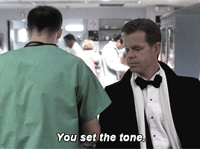
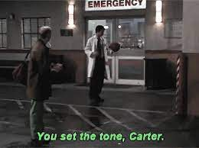
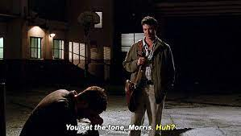
“You Set the Tone”
Staff Plus Roles and Archetypes
Moving Beyond Code
Technical Leadership
Work on What Matters

Slide 31
Voice of Experience
Staff Plus Roles and Archetypes
Moving Beyond Code
Technical Leadership
Work on What Matters
Key Values of Experience
- You remain “cool under fire”, because you have “seen it all before”
- You understand “trade offs” because you have seen the impact of decisions
- You personal goals rely less on the short term vs. long term
- Your market value is not the current framework, language etc.
Notes:
Key value: You remain calm and dispassionate, because you have seen it before
You learn from seeing the results of your work -> you have to stay long enough
Understand cost/value of taking risks.
Understand maintenance not just construction (30% of cost is rework; 90% of cost in maintenance)
You have seen "trade offs" play out

Slide 32
Noise to Signal
Staff Plus Roles and Archetypes
Moving Beyond Code
Technical Leadership
Work on What Matters
A key part of your role is to pull signal from noise for stakeholders
- Engineering environments have a lot of signals
- Stakeholders may not have the experience/skills to understand them
- Teams may shout loud about their agenda. Local Optima.
- Your position should give you perspective to be an honest broker
- Stakeholders rely on you to sort the signal from this noise
- Don’t breach trust. Check your own bias with others.
Notes:
Provide clarity amid noise
Synthesize information
Provide clarity to stakeholders
Ask for decisions with clear options, don’t bring chaos
Borg Queen

Slide 33
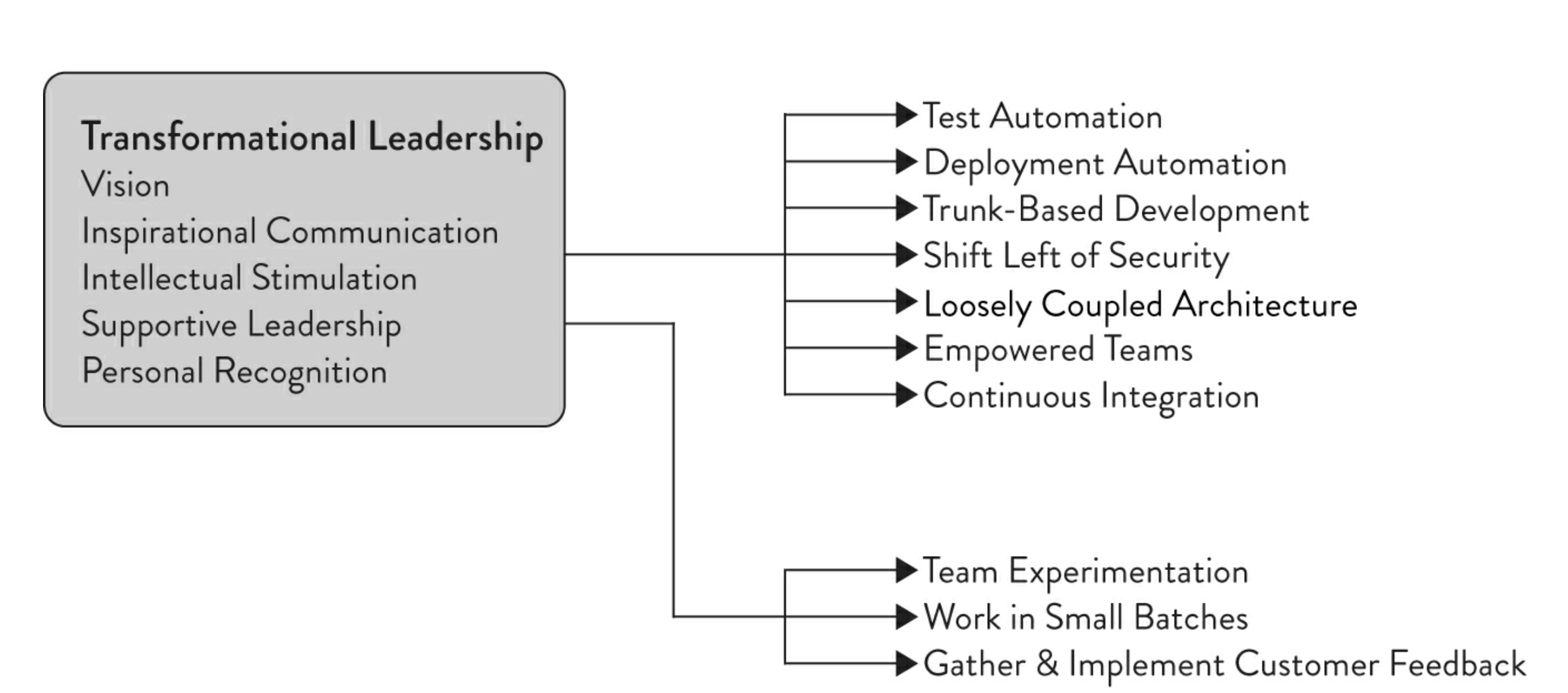
Transformational Leadership
Staff Plus Roles and Archetypes
Moving Beyond Code
Technical Leadership
Work on What Matters
Forsgren, Humble, Kim – Accelerate

Slide 34
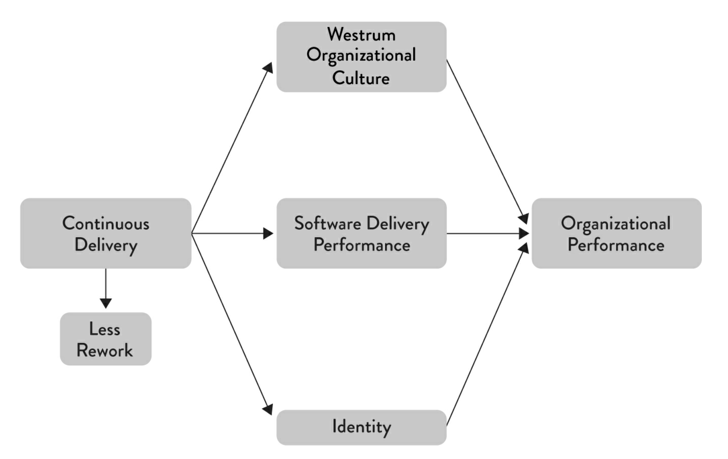
Transformational Leadership
Staff Plus Roles and Archetypes
Moving Beyond Code
Technical Leadership
Work on What Matters
Forsgren, Humble, Kim – Accelerate

Slide 35
Bad Ideas
Staff Plus Roles and Archetypes
Moving Beyond Code
Technical Leadership
Work on What Matters
Feeling the need to “prove” your technical authority
- Domination through demonstration of your "superior knowledge"
- You are a leader, not a master
- “Hero” actions on a project marginalize others
- Your job is to raise them up, not crush them down.
- Assume the room gives you the benefit of the doubt
Always speaking first
- Speak last.
Notes:
Feeling the need to prove yourself.
May lead to "hero" actions that marginalise others
May lead to trying to create a hierarchy through demonstration of your "superior knowledge"
Assume the room gives you the benefit of the doubt and capability for the role
If in doubt, say less.
Speaking First
Try to speak last

Slide 36
Agenda
Staff Plus Roles and Archetypes
Moving Beyond Code
Technical Leadership
Work on What Matters

Slide 37
Demonstrate Impact
Staff Plus Roles and Archetypes
Moving Beyond Code
Technical Leadership
Work on What Matters
You are expensive, compared to an entry-level hire.
- You will need to demonstrate your impact.
- Or you are vulnerable in any cost reduction exercise.
Your role is to tackle the messy, thorny, persistent problems
- The ones everyone recognizes, but no one else can get traction on.
- If anyone could solve it, you don’t demonstrate your value.
- Once the problem becomes tractable, move on, but check in.
Notes:
You are expensive, you will need to demonstrate impact
Deal with messy, complex, thorny problems
once they are less messy, thorny you may move on but continue to “check in”

Slide 38
The Long View
Staff Plus Roles and Archetypes
Moving Beyond Code
Technical Leadership
Work on What Matters
Your role is to advocate for the long view
- Local optima vs. perspective to think "in the large"
Use data to validate what you want to work on
- Given limited resources is it the most impactful problem to solve right now
Build an Architecture Runway
- What planes do you need to land?
Notes:
You have the longer view
Local optima may make sense to a team, but you should have perspective to think "in the large"
Tragedy of the Commons does not exist btw
See Ostrom for how to build orgs that share
https://www.onthecommons.org/magazine/elinor-ostroms-8-principles-managing-commmons
Validate what you want to work on?
It may be a problem, but given limited resources is it the most impactful problem to solve right now
Not all of a system will be well designed
Focus on the core
Purpose Alignment Matrix
Architecture Runway
Try to get ahead of need

Slide 39
You Set The Agenda
Staff Plus Roles and Archetypes
Moving Beyond Code
Technical Leadership
Work on What Matters
Most likely, no one will tell you what your agenda is
- Your manager’s role will be to validate your agenda.
- If you look for it, there will be too much to do
- If you are visible, there will be too many requests
- Your manager’s role is to give you the context to prioritize.
Notes:
Most likely you will propose what needs your attention
Your manager’s role is to validate, provide context, remove blockers, not set work assignments
Likely that you will not have enough time to satisfy all requests
Manager should provide context for you to prioritise where you can have most impact

Slide 40
Work on Important Things
Staff Plus Roles and Archetypes
Moving Beyond Code
Technical Leadership
Work on What Matters
Let folks know what you are accomplishing
- Brag Document
- What I am Thinking
Deliver
- You will need to deliver high-profile work
- Too much “glue work” won’t get you recognition
- What is the most important problem to solve right now!
Notes:
Manage Up
You need to manage up
Brag List
Thoughts
Deliver
You need to be able to point to what you have delivered
You will need to deliver high-profile enough initiatives to justify being staff plus
If you are just doing "senior engineer" work you will be seen as expensive for that
You might be quietly improving day-to-day life, but you need to make that higher profile
Show the org that your time their matters
Measure, show you met outcomes

Slide 41
Priority Lists
T:5
Staff Plus Roles and Archetypes
Moving Beyond Code
Technical Leadership
Work on What Matters
Rank your work according to priority
- Allocate your time according to those priorities
- If your highest priority takes too much time, drop stuff lower down.
Notes:
Rank all your in-flight work according to priority
Make sure you allocate your time according to those priorities
If your highest priorities take more time, drop things at the bottom

Slide 42
Not All of a System will be Well Designed
Staff Plus Roles and Archetypes
Moving Beyond Code
Technical Leadership
Work on What Matters
High
Partner
Differentiating
Market Differentiation
Neil Nickolaisen – The Purpose Alignment Mdel
Who Cares
Parity
Low
Mission Critical
High
Notes:
Not all of a system will be well designed
Focus on the core
Purpose Alignment Matriix

Slide 43
Is It Achievable?
Staff Plus Roles and Archetypes
Moving Beyond Code
Technical Leadership
Work on What Matters
Is your Vision achievable?
- If not, you wasted your time no matter how “right” you are.
Where possible, make small decisions, repeatedly
- Better to make lots of small decisions because it’s easier to correct course.
- It is also easier to sell.
- All successful complex systems started as a simple system and evolved.
- No successful systems ever started as complex
Notes:
Is it achievable
Your vision may be correct, but if it will never be implemented, you wasted a lot of time
Not all of a system will be well designed
Make Lots of Small Decisions
Better to make lots of small decisions that can be reversed over big decisions
But make decisions...
Your job is not to be paralysed by options, but to use your experience to make a choice
Trade Offs

Slide 44
Customer’s Matter
Staff Plus Roles and Archetypes
Moving Beyond Code
Technical Leadership
Work on What Matters
Always measure success from your Customers point of view
- If your customers are inside the company – this still counts!!
- Without understanding your customer’s need, you can’t asses importance.
Notes:
You need to measure success from your customer’s point of view. (If your customers are other teams inside your company, this still applies!) If you don’t understand your customer, you don’t have real perspective on what’s important.

Slide 45
You Solve Problems
Staff Plus Roles and Archetypes
Moving Beyond Code
Technical Leadership
Work on What Matters
Does this problem need solving?
- Is anyone already trying to solve it?
Understand and Explain
Make the work simpler and/or easier.
Use influence to gain organizational support
Make an alternative plan.
Notes:
Solving problems
Does this need solving?
Is anyone already solving it?
Can you join?
What do you bring to the room?
Can you be informed over involved?
Sometimes just being informed focuses the minds of those doing
Will someone inside recommend that you join?
Is there a sponsor?
Try getting sponsorship team before pushing your way in.
Key aspect of the role
Understand and Explain
Make the Work Easier
Get Organisational Support
Make Alternative Plans

Slide 46
Let Others Have Their Trouble
Staff Plus Roles and Archetypes
Moving Beyond Code
Technical Leadership
Work on What Matters
You may have the experience to step into many roles
- Let other people step up to do their jobs.
- Will it really fail if you don’t step in.
- Will the organization learn better from the pain of being allowed failure?
- Is there a more important demand on your time?
Notes:
You may have experience of a lot of roles...
Let other people do their job.
Assume competence
Is their failing really going to mean your failure?
If not, it may not be worth your time

Slide 47
Bad Ideas
Staff Plus Roles and Archetypes
Moving Beyond Code
Technical Leadership
Work on What Matters
Spending all your time on “glue”.
Not recognizing that your impact needs to be visible.
- Too much British modesty.
- It’s not enough to be virtuous, you need to be seen to be virtuous.
Notes:
Working on Projects that Don’t Have Impact
Too many Glue projects, not enough Delivery

Slide 48
Agenda
Staff Plus Roles and Archetypes
Moving Beyond Code
Technical Leadership
Work on What Matters

